Slide 1
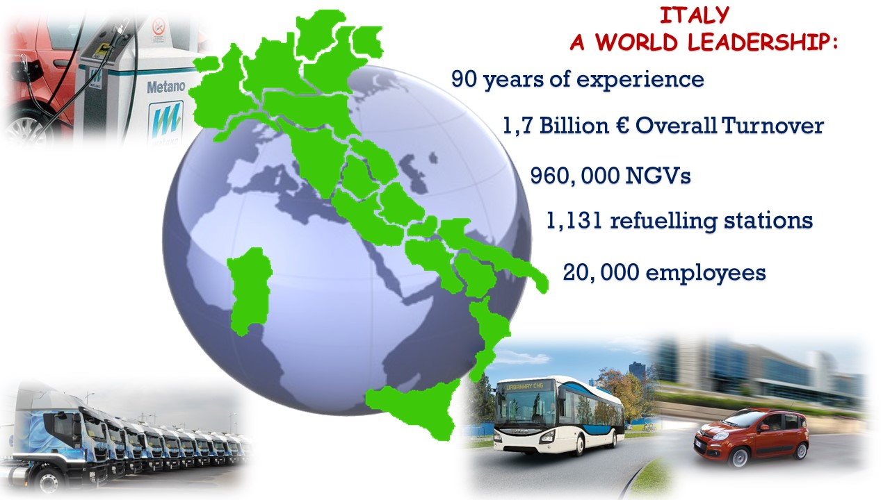

Slide 2



NGV System Italia, the association of the Italian Industry for natural gas in transport, dates back to 1996, bringing together the most significant companies whose products allow and ease the use of natural gas in transport
The NGV System Italia represents a professional family that:
includes HD & LD OEMs as well as the most qualified Italian system and equipment manufacturers.
takes part in national and international standards development.
is a privileged environment for information and knowhow exchange.
constitutes a an important institutional stakeholder for development of Natural Gas in Transport
is NGV GLOBAL B.O.D. member, NGV EUROPE member, ANGVA member

Slide 4

NGVs DEVELOPMENT KEY FACTORS:
        Available and affordable technology
        Fuels price differencial
        Developed refuelling network
        Applicable standards and Regulations
        Competence of operatives
        Environmental benefits

Slide 5
The importance of Natural Gas for transport in ITALY
Incentives

Slide 6
NG
LPG

Slide 7
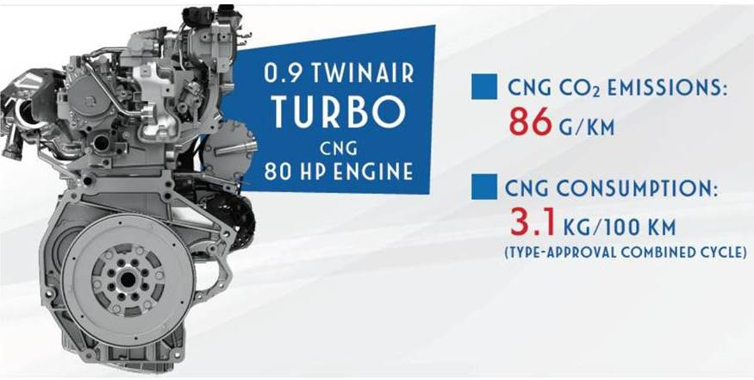
Technology

Slide 9

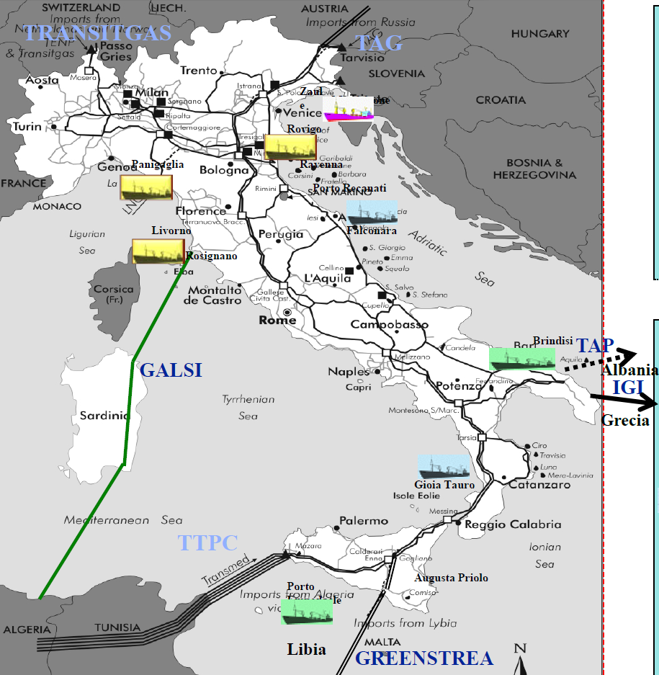

ITALIAN “BLU CORRIDOR”
LNG TERMINALS
EXISTING
UNDER CONSTRUCTION
STAND BY
UNDER DESIGN

